Slide 1

Supply Chain Analysis Report
Insights from Transaction, Product, Demographic, and Stock Data
Srushti More
July 2025

Slide 2





Overview: Key Supply Chain Insights
This report summarises key findings from our comprehensive supply chain data analysis, focusing on transaction modes, product performance, customer demographics, revenue by route, and stock levels.
Road Dominates
Rail's Strong Presence
Sea Least Preferred
Road transport is our most frequently used mode for transactions, highlighting its critical role in our logistics network.
Rail transport closely follows Road as a significant transaction mode, indicating its importance for long-haul efficiency.
Sea transport is currently our least preferred mode, suggesting potential areas for review regarding cost-efficiency or speed.
Action: Prioritise optimising Road and Rail logistics. Review the cost-efficiency and feasibility of increasing Sea mode usage where applicable.

Slide 3
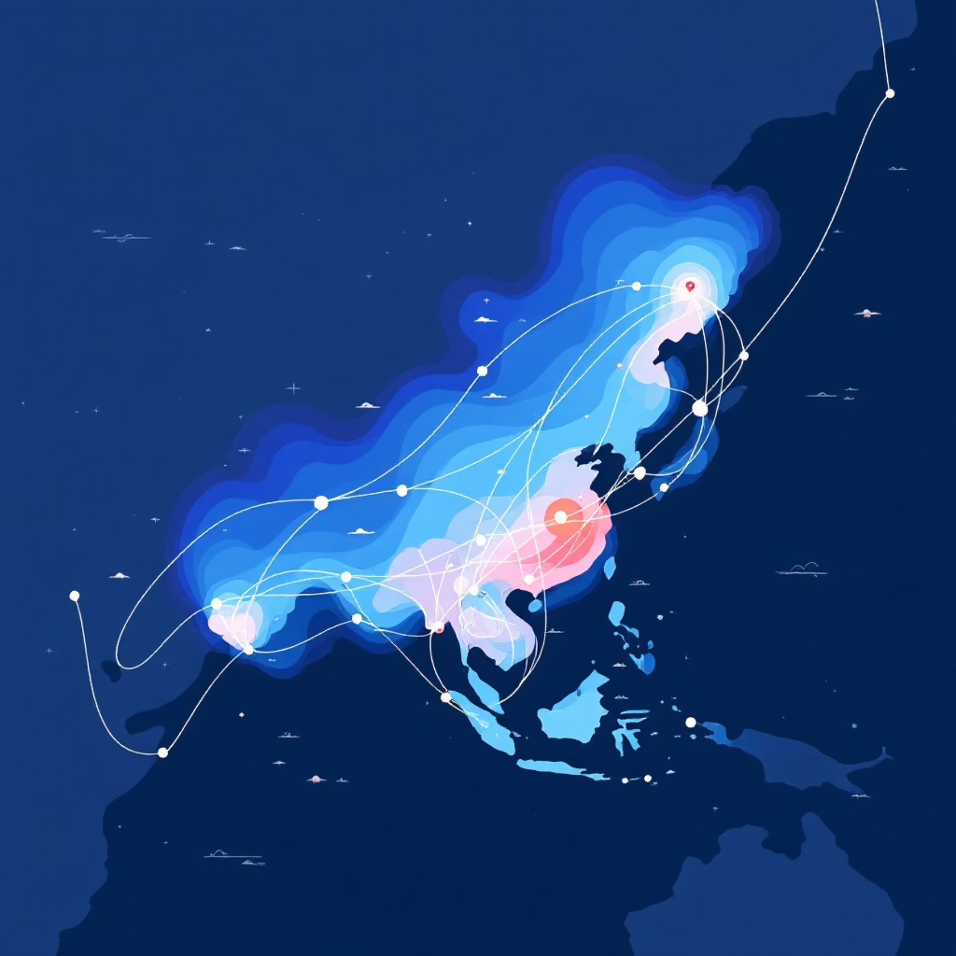
Optimising Routes & Data Quality
Route Performance
Insight: Route A consistently demonstrates optimal performance, making it a prime candidate for prioritised supply runs.
Interpretation: Route C, however, shows signs of underperformance and may require efficiency improvements or a complete reevaluation.
Customer Data Quality
Product Revenue Drivers
A high percentage of 'Unknown' demographic data points to a significant gap in our data capture processes.
Skin Care products are the primary revenue drivers. This category should be a focal point for future promotional activities. Cosmetic products may require repositioning or optimization strategies.

Slide 4

Stock Management & Profitability Deep Dive
Stock Level Insights
Hair Care shows potential overstocking risks, indicating a need for reevaluation of inventory levels to prevent holding costs.
Cosmetic products currently exhibit low stock levels, which aligns with their lower sales performance.
Interpretation: Skin Care products stand out with both high revenue and strong profit margins, solidifying their position as a core growth area for the business. The Cosmetic category, despite its sales figures, requires a thorough profitability review to identify areas for improvement.

Slide 5
Final Recommendations for Supply Chain Enhancement
Strategic Focus
✅ Concentrate marketing efforts and optimise logistics specifically for the high-performing Skin Care category.
Data Improvement
✅ Implement measures to enhance customer data quality, aiming to significantly reduce 'Unknown' demographic entries.
Logistics Optimisation
✅ Invest further in Road and Rail transport modes to leverage their current high utilisation and improve overall efficiency.
Inventory Management
✅ Reevaluate and refine stock planning strategies for Hair Care and Cosmetic categories to prevent overstocking or stockouts.
Route Performance Review
✅ Conduct a detailed review of underperforming routes, such as Route C, to identify bottlenecks and implement corrective actions.

Slide 6

Thank You!

